Slide 1
Practical Firmware Reversing and Exploit Development for AVR-based Embedded Devices
Alexander @dark_k3y Bolshev
Boris @dukeBarman Ryutin

Slide 2
Agenda
Part 1: Quick RJMP to AVR + Introduction example
Part 2: Pre-exploitation
Part 3: Exploitation and ROP-chains building
Part 4: Post-exploitation and tricks

Slide 3
Disclaimer: 1) Training is VERY fast-paced 2) Training is highly-practical 3) You may encounter information overflow 4) Our English is far from perfect
Thus: If you have a question, please interrupt and ask immediately
Image Credit: Marac Kolodzinski

Slide 4
Part 1: What is AVR?

Slide 5
AVR
Alf (Egil Bogen) and Vegard (Wollan)’s RISC processor
Modified Harvard architecture 8-bit RISC single-chip microcontroller
Developed by Atmel in 1996 (now Dialog/Atmel)
Image: https://de.wikipedia.org/wiki/Atmel AVR

Slide 6
AVR is almost everywhere
Industrial PLCs and gateways
Home electronics: kettles, irons, weather stations, etc
IoT
HID devices (ex.: Xbox hand controllers)
Automotive applications: security, safety, powertrain and entertainment systems.
Radio applications (and also Xbee and Zwave)
Arduino platform
WirelessHART transmitters and sensors
Your new shiny IoE fridge ;-)

Slide 7
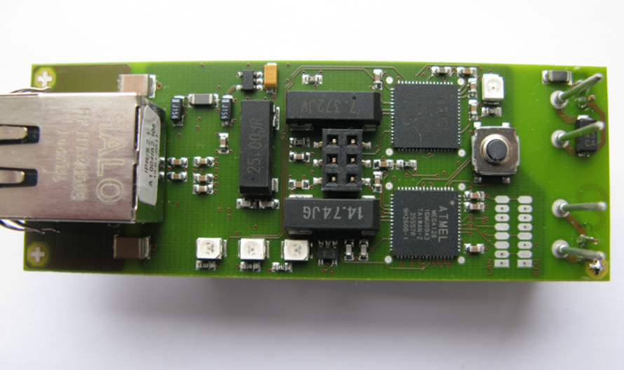
AVR inside industrial gateway

Slide 8
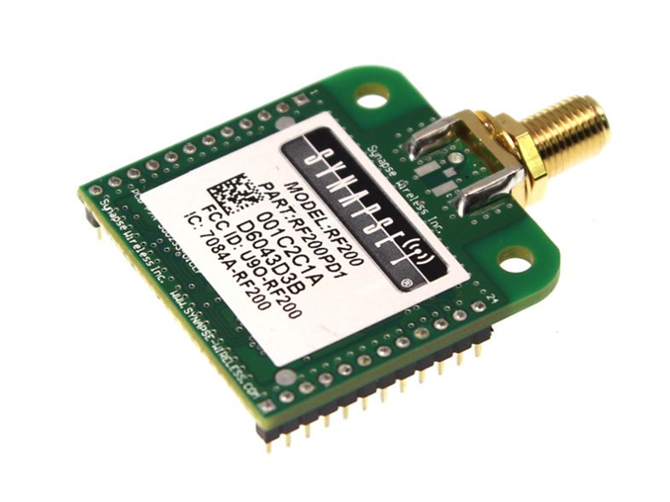
Synapse IoT module with Atmega128RFA1 inside

Slide 9
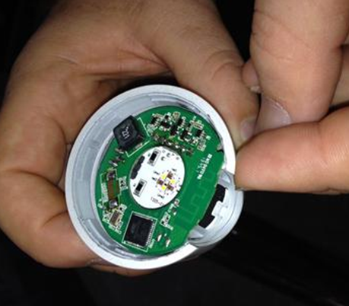
Philips Hue Bulb
http://www.eetimes.com/document.asp?doc_id=1323739&image_number=1

Slide 10
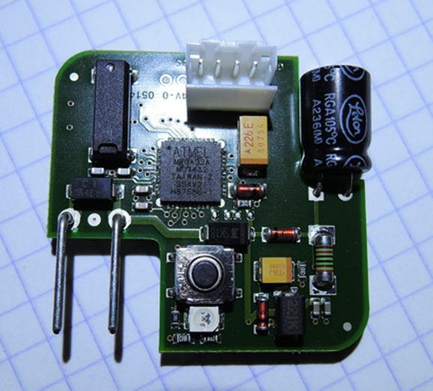
AVR inside home automation dimmer

Slide 11
Harvard Architecture

Slide 12
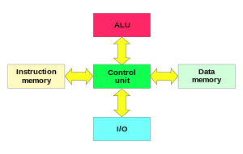
Harvard Architecture
Physically separated storage and signal pathways for instructions and data
Originated from the Harvard Mark I relay-based computer
Image: https://en.wikipedia.org/wiki/Harvard architecture

Slide 13
Modified Harvard architecture…
…allows the contents of the instruction memory to be accessed as if it were data¹
¹but not the data as code!

Slide 14

Introduction example: We’re still able to exploit!

Slide 15
AVR “features”

Slide 16
AVR-8
MCU (MicroController Unit) -- single computer chip designed for embedded applications
Low-power
Integrated RAM and ROM (SRAM + EEPROM + Flash)
Some models could work with external SRAM
8-bit, word size is 16 bit (2 bytes)
Higher integration
Single core/Interrupts
Low-freq (<20MHz in most cases)

Slide 17
Higher Integration
Built-in SRAM, EEPROM an Flash
GPIO (discrete I/O pins)
UART(s)
I²C, SPI, CAN, …
ADC
PWM or DAC
Timers
Watchdog
Clock generator and divider(s)
Comparator(s)
In-circuit programming and debugging support

Slide 18
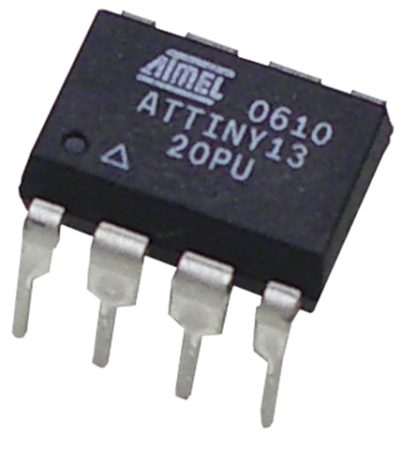
AVRs are very different
AtTiny13
Up to 20 MIPS Througput at 20 MHz
64 SRAM/64 EEPROM/1k Flash
Timer, ADC, 2 PWMs, Comparator, internal oscillator
0.24mA in active mode, 0.0001mA in sleep mode

Slide 19
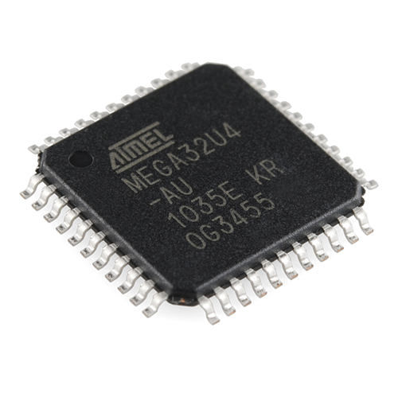
AVRs are very different
Atmega32U4
2.5k SRAM/1k EEPROM/32k Flash
JTAG
USB
PLL, Timers, PWMs, Comparators, ADCs, UARTs, Temperatures sensors, SPI, I²C, … => tons of stuff

Slide 20
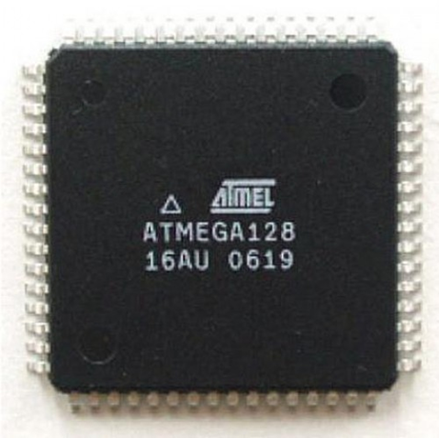
AVRs are very different
Atmega128
4k SRAM/4k EEPROM/128k Flash
JTAG
Tons of stuff…
The workshop focuses on this chip

Slide 21
Why Atmega128?
Old, but very widespread chip
At90can128 – popular analogue for CAN buses in automotive application
Cheap JTAG programmer
Much SRAM == ideal for ROP-chain construction training
Let’s look to the architecture of Atmega128…

Slide 22
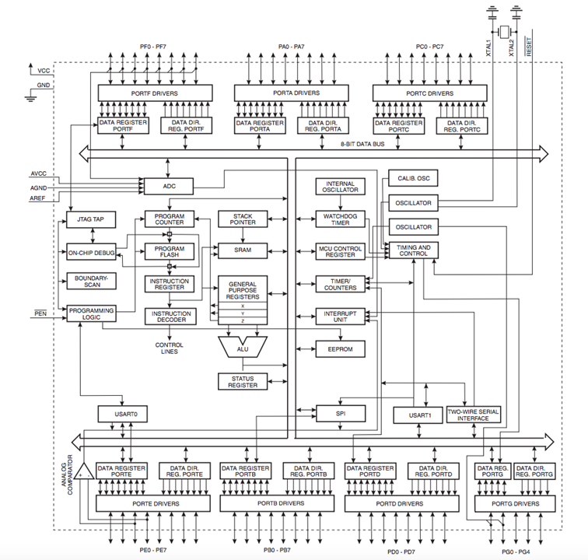

Slide 23


Slide 24
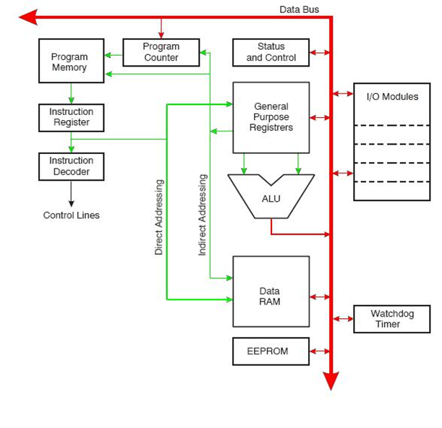
Ok, ok, let’s simplify a bit ☺
Image: http://www.cs.jhu.edu/~jorgev/cs333/usbkey/uC_3.JPG

Slide 25

Note: code is separated from data

Slide 26
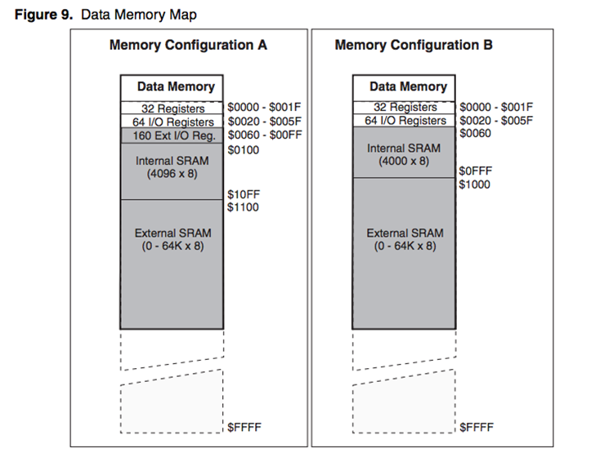
Memory map

Slide 27
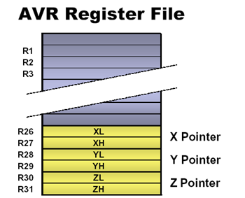
Memory: registers
R0-R25 – GPR
X,Y,Z – pair “working” registers, e.g. for memory addressing operations
I/O registers – for accessing different “hardware”

Slide 28
Memory: special registers
PC – program counter, 16-bit register
SP – stack pointer, 16-bit register (SPH:SPL)
SREG – status register (8-bit)
Notes:
More about SP, PC and SREG

Slide 29
Memory addressing
SRAM/EEPROM – 16-bit addressing, 8-bit element
Flash – 16(8)-bit addressing, 16-bit element
LPM command!

Slide 30
Memory addressing directions
Direct to register
Direct to I/O
SRAM direct
SRAM indirect (pre- and post- increment)
Flash direct
Notes:
Add more slides about directing in full version

Slide 31

Datasheets are your best friends!

Slide 32


Slide 33
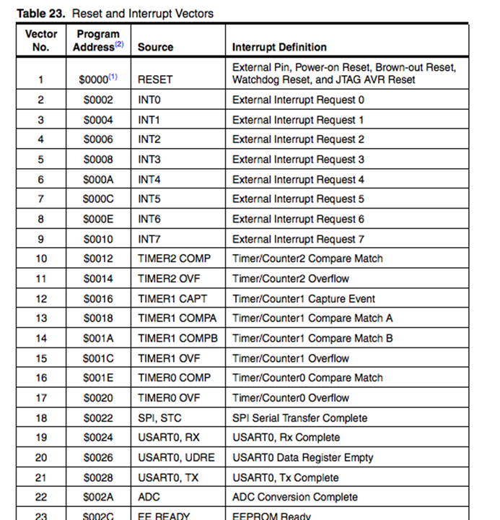
Interrupts
Interrupts interrupt normal process of code execution for handling something or reacting to some event
Interrupt handler is a procedure to be executed after interrupt; address stored in the interrupt vector
Examples of interrupts:
Timers
Hardware events
Reset

Slide 34
AVR assembly
Very quickly

Slide 35
Instruction types
Arithmetic and logic
Bit manipulation/test
Memory manipulation
Unconditional jump/call
Branch commands
SREG manipulation
Special (watchdog, etc)

Slide 36
Instruction mnemonics
mov r16,r0 ; Copy r0 to r16
out PORTA, r16 ; Write r16 to PORTA
16-bit long
“Intel syntax” (destination before source)

Slide 37
A bit more about architecture

Slide 38
Fuses and Lock Bits
Several bytes of permanent storage
Set internal hardware and features configuration, including oscillator (int or ext), bootloader, pins, ability to debug/program, etc.
2 lock bits controls programming protection.

Slide 39
AVR bootloader – what is it?
Part of code that starts BEFORE RESET interrupt.
Could be used for self-programmable (i.e. without external device) systems, in case you need update the firmware of your IoT device.
Bootloader address and behavior configured via FUSEs.
BLB lock bits controls bootloader ability to update application and/or bootloader parts of flash.

Slide 40
AVR bootloaders
Arduino bootloader
USB bootloaders (AVRUSBBoot)
Serial programmer bootloaders (STK500-compatible)
Cryptobootloaders
…
Tons of them!

Slide 41
Watchdog
Timer that could be used to interrupt or reset device.
Cleared with WDR instruction.
http://ardiri.com/blog/entries/20141028/watchdog.jpg

Slide 42
Development for AVR

Slide 43
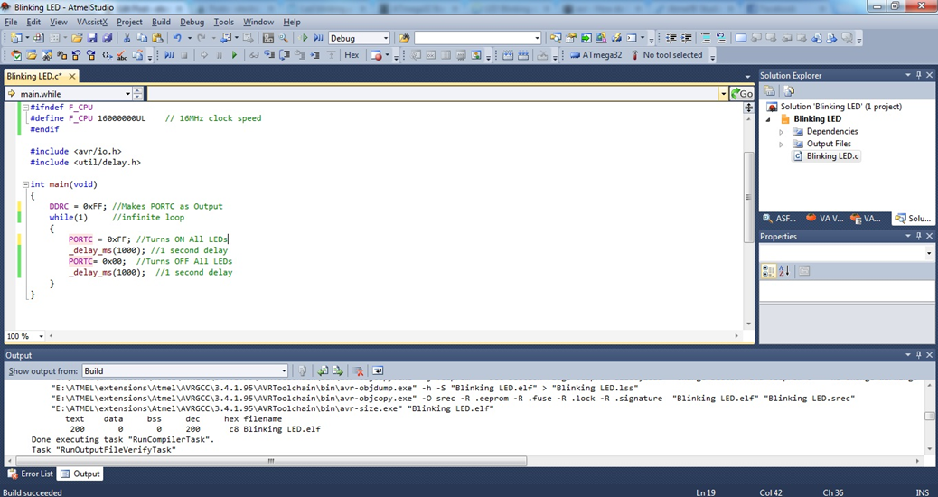
Atmel studio

Slide 44
AVR-GCC
Main compiler/debugger kit for the platform
Used by Atmel studio
Use “AVR libc” -- http://www.nongnu.org/avr-libc/
Several optimization options, several memory models

Slide 45
Other tools
Arduino
CodeVision AVR
IAR Embedded workbench

Slide 46
Debugging AVR

Slide 47
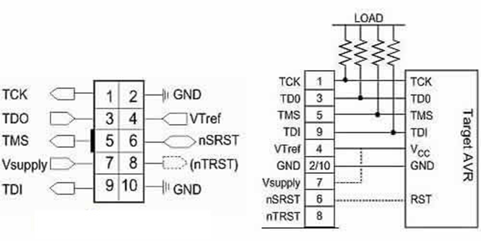
JTAG
Joint Test Action Group (JTAG)
Special debugging interface added to a chip
Allows testing, debugging, firmware manipulation and boundary scanning.
Requires external hardware

Slide 48
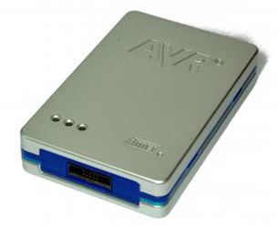
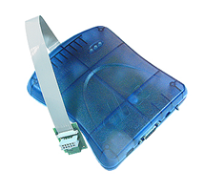
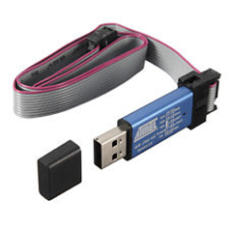

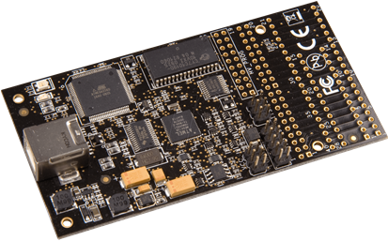
JTAG for AVRs
AVR JTAGIce3
AVR JTAG mkII
AVR JTAG mkI
Atmel ICE3
AVR Dragon

Slide 49
Avarice
Open-source interface between AVR JTAG and GDB
Also allow to flash/write EEPROM, manipulate fuse and lock bits.
Could capture the execution flow to restore the firmware
Example usage:
avarice --program --file test.elf --part atmega128 --jtag /dev/ttyUSB0 -d :4242

Slide 50
AVR-GDB
Part of “nongnu” AVR gcc kit.
Roughly ported standard gdb to AVR platform
Doesn’t understand Harvard architecture
You will need to resolve memory address by reference of $pc to read the flash
(gdb) x/10b $pc + 100

Slide 51
Simulators
Atmel Studio simulator
Proteus simulator
Simavr
Simulavr

Slide 52
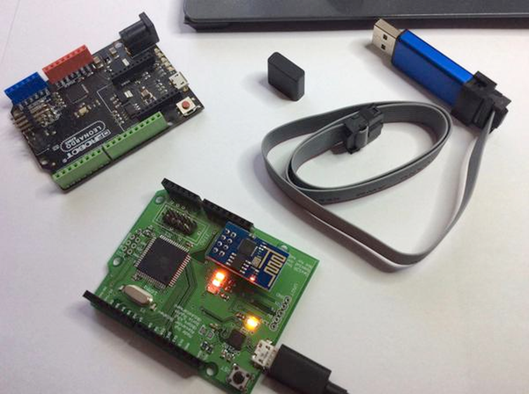
Training kit content
AVR JTAG mkI
Arduino
ESP8266 “WiFi to serial”
Atmega128 custom
devboard

Slide 53
VM access:
Login: radare
Password: radare

Slide 54

Ex 1.1: Hello world!
cd /home/radare/workshop/ex1.1
avarice --mkI --jtag /dev/ttyUSB0 -p -e --file hello.hex
Communication: CuteCom or Ccreen /dev/ttyUSB1 9600
For debugging:
avarice --mkI --jtag /dev/ttyUSB0 -p -e --file hello.hex -d :4242
In new terminal window:
avr-gdb
(gdb) target remote :4242

Slide 55
Ex 1.1_simulator: Hello world!
Simulator
cd /home/radare/workshop/ex1.1_simulator
simulavr -d atmega128 -f hello.elf -F 16000000 -x -,E1,9600 -y -,E0,9600
For debugging:
simulavr -d atmega128 -f hello.elf -F 16000000 -x -,E1,9600 -y -,E0,9600 -g
avr-gdb
(gdb) target remote :1212

Slide 56
Ex 1.2: Blink!
cd /home/radare/workshop/ex1.2
avarice --mkI --jtag /dev/ttyUSB0 -p -e --file blink.hex
For debugging:
avarice --mkI --jtag /dev/ttyUSB0 -p -e --file blink.hex -d :4242
avr-gdb
(gdb) target remote :4242

Slide 57
Part 2: Pre-exploitation

Slide 58
You have a device. First steps?
Decide what you want
Determine target platform
Search for I/O point(s)
Search for debug point(s)
Acquire the firmware
Fuzz and/or static analysis

Slide 59
Let’s start with a REAL example
Let’s use training kit board as an example
Imagine that you know nothing about it
We will go through all steps, one by one

Slide 60
What we want?
To start with, decide what you want:
Abuse of functionality
Read something from EEPROM/Flash/SRAM
Stay persistent
Complexity

Slide 61
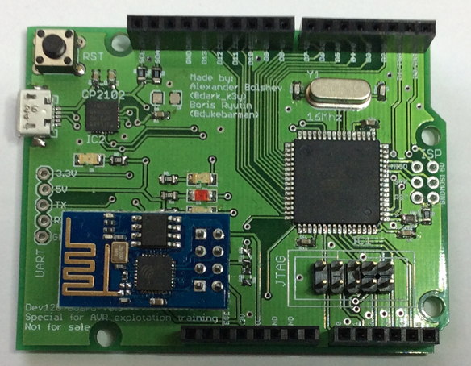
Determine target platform
Look at the board and search for all ICs…
CP2102
Atmega128 16AU
ESP8266EX

Slide 62
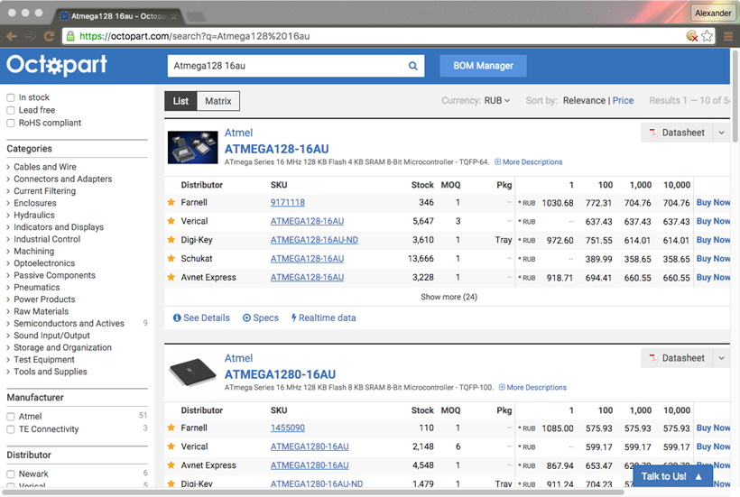
Digikey/Octopart/Google…

Slide 63
Search for I/O(s)
External connectors
USB
UART
External connectors
Antenna

Slide 64
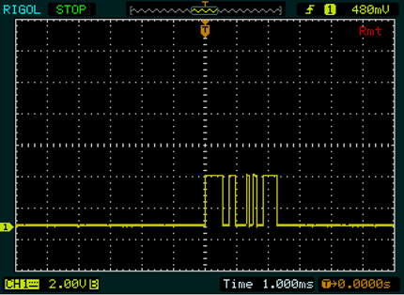
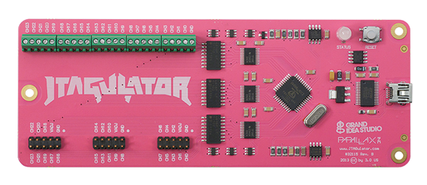
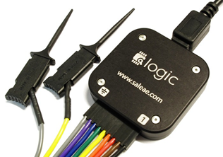

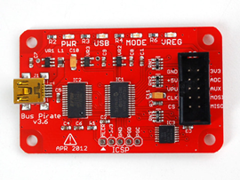
Search for I/O(s): tools
Jtagulator
Bus pirate
Saleae logic analyzer
Arduino

Slide 65
Search for debug interface(s)
ISP
JTAG

Slide 66
Search for debug interface(s): tools
Or cheaper
Jtagulator
Arduino + JTAGEnum

Slide 67
JTAGEnum against Atmega128 demoboard
Connect Arduino to Atmega128 demoboard
Connect Arduino to PC with USB cable
cd ~/workshop/JTAGenum
make upload (click reset on arduino just before it)
screen /dev/ttyACM0 115200
Press “s”

Slide 68

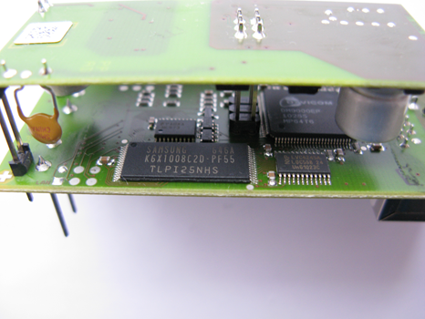
Search for debug & I/O: real device
Connector
ICS bus
Button
2 JTAGs
Ethernet
ISPs
LEDs

Slide 69
Acquire the firmware
From vendor web-site ☺
Sniffing the firmware update session
From device itself

Slide 70
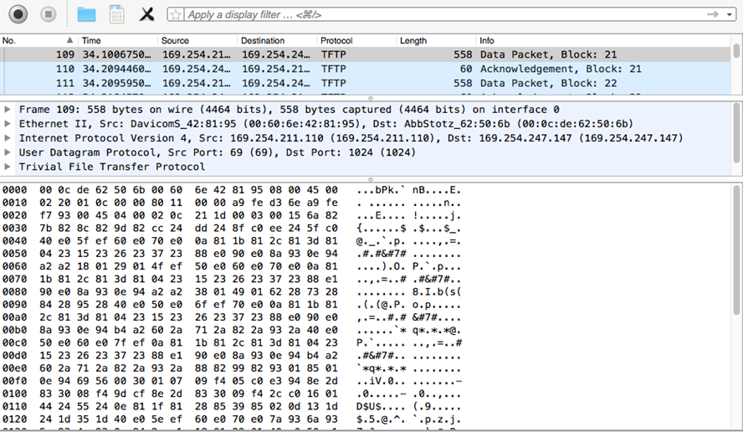
Acquiring the firmware: sniff it!

Slide 71
Acquiring the firmware: JTAG or ISP
Use JTAG or ISP programmer to connect to the board debug ports
Use:
Atmel Studio
AVRDude
Programmer-specific software to read flash
$ avrdude -p m128 -c jtag1 –P /dev/ttyUSB0 \
-U flash:r:"/home/avr/flash.bin":r

Slide 72
Acquiring the firmware: lock bits
AVR has lock bits that protect device from extracting flash
Clearing these lockbits will erase the entire device
If you have them set you’re not lucky --> try to get firmware from other sources
However, if you have lock bits set but JTAG is enabled you could try partial restoration of firmware with avarice –capture (rare case)

Slide 73
Exercise 2.0: Fuses
Read fuses and lock bits using
avarice --mkI --jtag /dev/ttyUSB0 –r -l

Slide 74
Firmware reversing: formats
Raw binary format
ELF format for AVRs
Intel HEX format (often used by programmers)
Could be easily converted between with avr-objcopy, e.g.:
avr-objcopy -I ihex -O binary blink.hex blink.bin

Slide 75
AVR RE

Slide 76
Reverse engineering AVR binaries
Pure disassemblers:
avr-objdump – gcc kit standard tool
Vavrdisasm -- https://github.com/vsergeev/vavrdisasm
ODAweb -- https://www.onlinedisassembler.com/odaweb/
“Normal” disassemblers:
IDA Pro
Radare

Slide 77
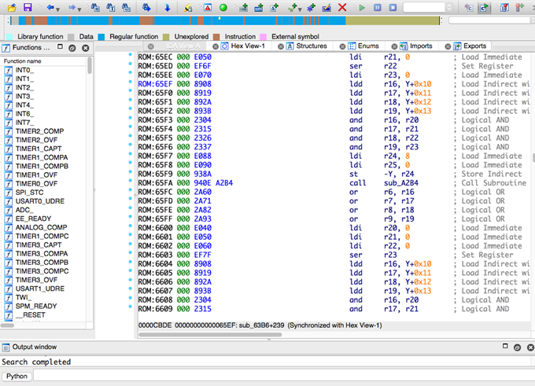
IDA PRO: AVR specifics
Incorrect AVR elf-handling
Incorrect LPM command behavior
Addressing issues
Sometimes strange output
...
Still usable, but “with care”
Notes:
https://www.hex-rays.com/products/ida/

Slide 78
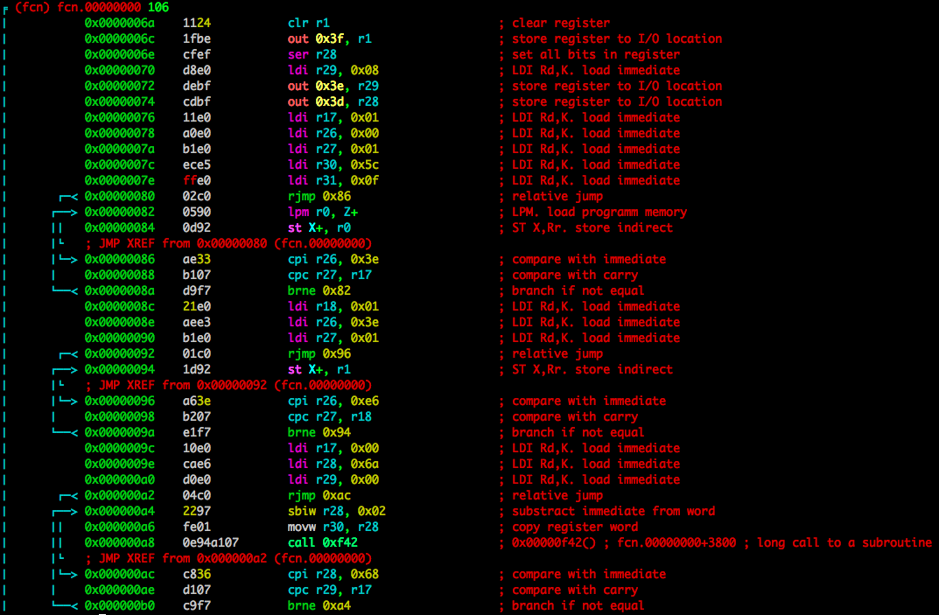
Radare2
Opensource reverse engineering framework (RE, debugger, forensics)
Crossplatform (Linux,Mac,Windows,QNX,Android,iOS, …)
Scripting
A lot of architectures / file-formats
…
Without “habitual” GUI (c) pancake
Notes:
http://www.radare.org/r/

Slide 79
Radare2: Tools
radare2
rabin2
radiff2
rafind2
rasm2
r2pm
rarun2
rax2
r2agent
ragg2
rahash2
rasign2
Notes:
http://www.radare.org/r/

Slide 80
Radare2: Usage
Install from git
# git clone https://github.com/radare/radare2
# cd radare2
# sys/install.sh
Packages (yara, retdec / radeco decompilers, …):
# r2pm -i radare2
Console commands
# r2 -d /bin/ls – debugging
# r2 –a avr sample.bin – architecture
# r2 –b 16 sample.bin – specify register size in bits
# r2 sample.bin –i script – include script
Notes:
http://www.radare.org/r/

Slide 81
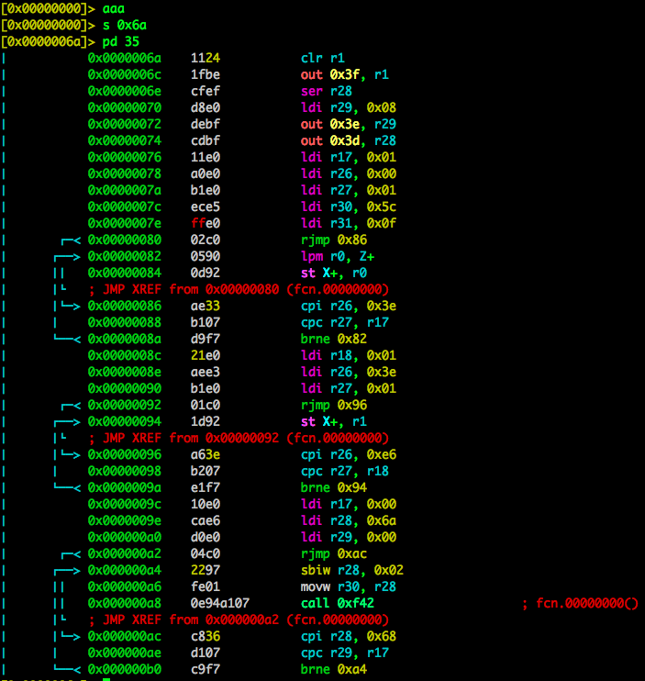
Radare2: Basic commands
aaa – analyze
axt – xrefs
s – seek
p – disassemble
~ - grep
! – run shell commands
/ – search
/R – search ROP
/c – search instruction
? – help
Notes:
http://www.radare.org/r/

Slide 82
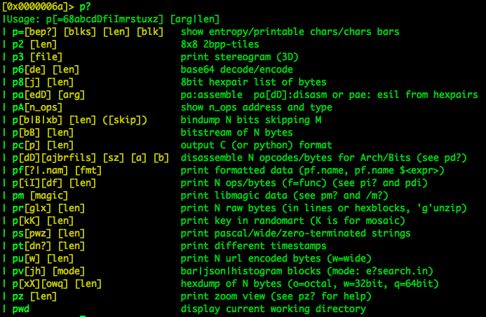
Radare2: Disassembling
p?
pd/pD - dissamble
pi/pI – print instructions
Examples:
> pd 35 @ function
Notes:
http://www.radare.org/r/

Slide 83
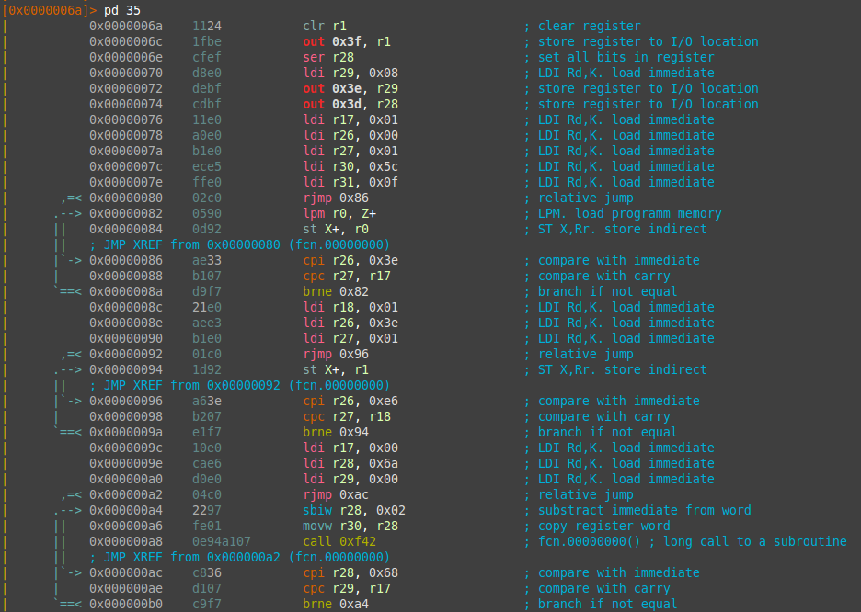
Radare2: Options
~/.radarerc
e asm.describe=true
e scr.utf8=true
e asm.midflags=true
e asm.emu=true
eco solarized
Notes:
http://www.radare.org/r/

Slide 84
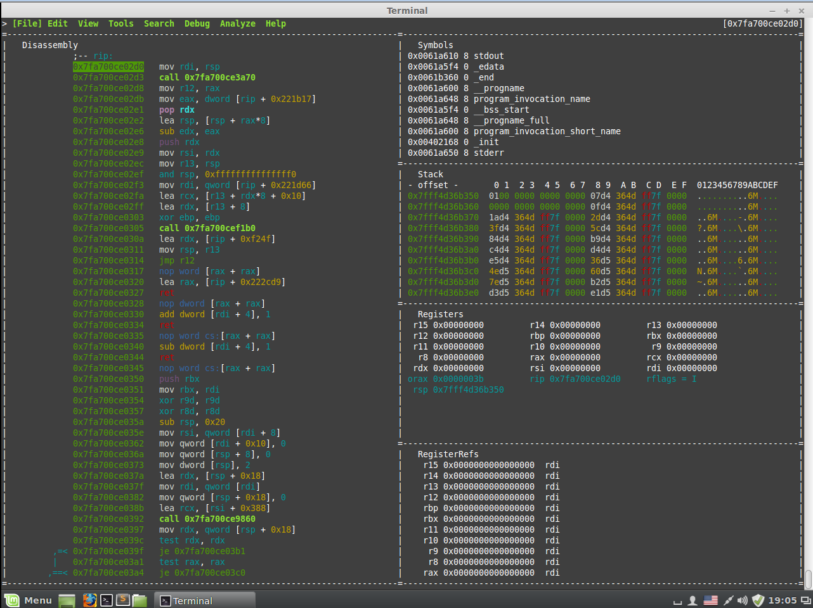
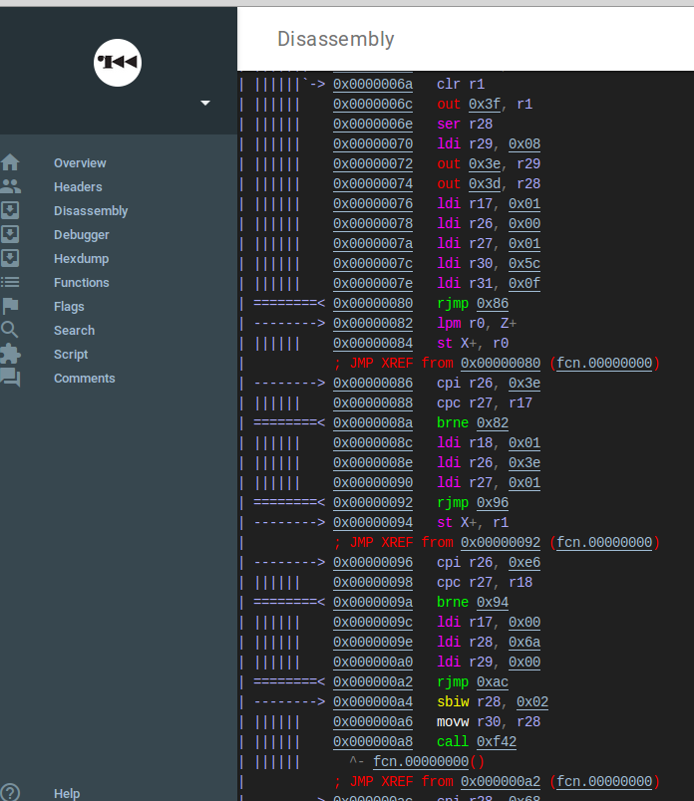
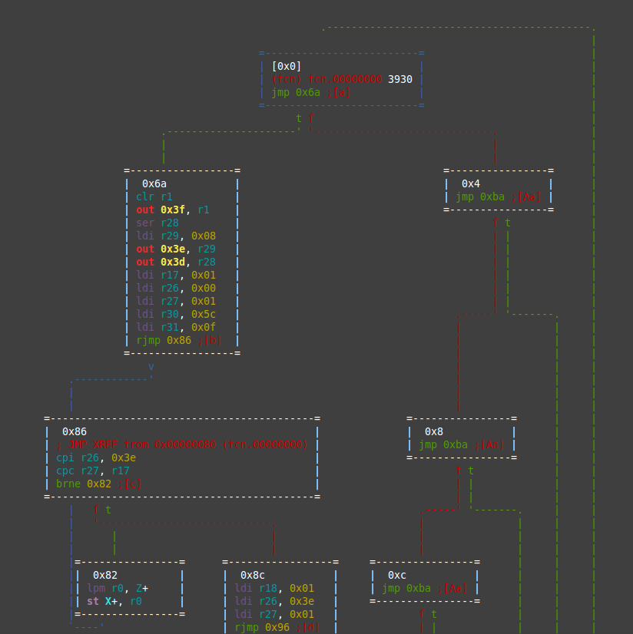
Radare2: Interfaces
ASCII – VV
Visual panels – V! (vim like controls)
Web-server – r2 -c=H file
Bokken
Notes:
http://www.radare.org/r/

Slide 85
Best combinations for AVR RE
Both Radare2 and IDA Pro have pitfalls when working with AVR
That’s why I am using the following combination
IDA Pro 6.6+ + Radare2 + GDB + avr-objdump
Here we will focus on Radare2 + GDB, because not everyone can afford latest IDA Pro ☹

Slide 86
Ex 2.1: Hello! RE
cd /home/radare/workshop/ex2.1
avr-objcopy –I ihex –O binary hello.hex hello.bin
r2 –a avr hello.bin

Slide 87
Now we will scrutinize every line of disassembled code. Boring, but is required for further understanding
http://reallycuteanimals.co.uk/wp-content/uploads/2012/06/120519-cat-keyboard_thumb.jpg

Slide 88
Interrupts vector && init section
Init section
Interrupts vector
main() →
Program halt

Slide 89
Memory manipulation: stack push
push r14 ; save r14 on the Stack
Some value
Some value
Some value
Some value
0x10
push r14
SP
r14 = 0x10
SP = SP - 1

Slide 90
Memory manipulation: stack pop
push r14 ; save r14 on the Stack
pop r15 ; pop top of Stack to r15
Some value
Some value
Some value
Some value
0x10
push r14
SP
r14 = 0x10
SP = SP - 1
Some value
Some value
0x10
Some value
Some value
pop r15
SP = SP + 1
r15 ← 0x10
SP

Slide 91
Unconditional jump/call
jmp 0xABC1 ; PC = 0xABC1
rjmp 5 ; PC = PC + 5 + 1
call 0xABC1 ; “push PC+2”
; jmp 0xABC1
ret ; “pop PC”

Slide 92

Harvard architecture? But PC goes to DATA memory

Slide 93
Arithmetic instructions
add r1,r2 ; r1 = r1 + r2
add r28,r28 ; r28 = r28 + r28
and r2,r3 ; r2 = r2 & r3
clr r1 ; r1 = 0
ser r28 ; r28 = 0xFF
inc r0 ; r0 = r0 + 1
neg r0 ; r0 = -r0
…

Slide 94
Memory manipulation: immediate values
ldi r29, 0x10 ; r29 = 0x10

Slide 95
Memory manipulation: ports
in r15, $16 ; r15 = PORTB
out $16, r0 ; PORTB = r0
What is the 0x3f, 0x3e, 0x3d and where to find them?

Slide 96
Datasheets are your best friends! (2)
P. 366 of Atmega128L datasheet

Slide 97
So, what’s going on here?
1
2
3
SREG (Status REGister) is cleared (set to r1 value, which is 0x00)
SPL ← r29 (0xFF)
SPH ← r28 (0x10)
After init:
SREG = 0, SP = 0x10FF = 4351(SRAM limit)

Slide 98
Going further

Slide 99
Memory manipulation: lds/sts
lds r2,0xFA00 ; r2 = *0xFA00
sts 0xFA00,r0 ; *0xFA00 = r0
Here:
*0x98 ← r1 (0x00)
r24 ← 0x67
*0x99 ← r24 (0x67)

Slide 100
Datasheets are your best friends! (3)
P. 365 of Atmega128L datasheet

Slide 101
What is it all about and why sts and not out?
UBRR1H = ( BAUD_PRESCALE >> 8) ;
10929800 sts 0x0098, r1
UBRR1L = ( BAUD_PRESCALE ) ;
87e6 ldi r24, 0x67
80939900 sts 0x0099, r24
Registers are also part of the RAM
Common rule:
Every IO/RAM address is reachable with sts/lds while in/out are used for (0x00 - 0x3F range)

Slide 102
Why 0x0067?
UBBRH:UBBRL for speed of UART
USART is clocking from internal generator (16MHz in our case)
We selected baud speed of 9600
The common formula of USART frequency divider for AVR (see datasheet for USART section, p.194+):
BAUD_PRESCALE = (F_CPU / (USART_BAUDRATE * 16)) – 1 =
= 16 000 000 / (9600 * 16) – 1 = 104.1666666(6) – 1 ~= 103 = 0x0067

Slide 103
More arithmetic instructions
andi r2, 0x10 ; r2 = r2 & 0x10
ori r24, 0x98 ; r24 = r24 | 0x98
…
UCSR1B |= (1 << RXEN1) | (1 << TXEN1) | (1 << RXCIE1);
Enables RX and TX lines, enable RX interrupt.
UCSR1C |= (1<<USBS1) | (3<<UCSZ10);
Set stop bit and character size

Slide 104
Functions && Calling conventions
send_byte('H');
Typical AVR calling convention for arguments
Call-used: R18–R27, R30, R31
Call-saved: R2–R17, R28, R29
R29:R28 used as frame pointer
We will discuss it in more details later.

Slide 105
_delay_ms(1000);
This “function” is inlined as:
subi r18,0x01 ; r18 = r18 – 1
sbci r24,0x00 ; r24 = r24 – 0 – C
; C – Carry flag from arithmetic operations (SREG)

Slide 106
Conditional jump
cpse r1, r0 ; r1 == r2 ?
PC ← PC + 2 : PC ← PC + 3
breq 10 ; Z ? PC ← PC + 1 + 10
brne -4 ; !Z ? PC ← PC + 1 - 4
…

Slide 107
Why -4?
f7e1 = 1111 0111 1110 0001
11 1110 0 in two’s complement form == -4

Slide 108
Special
break – debugger break
nop – no operation
sleep – enter sleep mode
wdr – watchdog timer reset

Slide 109
void send_byte(uint8_t byte)
while((UCSR1A &(1<<UDRE1)) == 0);
UDR1 = byte;

Slide 110
Conditional “skip”
sbrc r0,7 ; skip if bit 7 in r0 cleared
cpse r4,r0 ; skip if r4 == r0
sbrs r25,5 ; skip if bit 5 in r25 set

Slide 111
More things to know

Slide 112
Comparison
cp r4,r19 ; Compare r4 with r19
brne label1 ; jump if r19 != r4
; Compare r3:r2 with r1:r0
cp r2,r0 ; Compare low byte
cpc r3,r1 ; Compare high byte
brne label2 ; jump if r3:r2 != r1:r0
cpi r19,3 ; Compare r19 with 3
brne label3 ; jump if r19 != 3

Slide 113
SREG – 8-bit status register
C – Carry flag
Z – Zero flag
N – Negative flag
V – two’s complement oVerflow indicator
S – N ⊕ V, for Signed tests
H – Half carry flag
T – Transfer bit (BLD/BST)
I – global Interrupt enable/disable flag

Slide 114
SREG manipulations
sec/clc – set/clear carry
sei/cli – set/clear global interruption flag
se*/cl* – set/clear * flag in SREG

Slide 115
More memory manipulation
mov r1, r2 ; r1 = r2
st Z, r0 ; *Z(r31:r30) = r0
st –Z, r1 ; *Z-- = r1
std Z+5, r2 ; *(Z+5) = r2
…
Same for LD*
Direct
Indirect

Slide 116
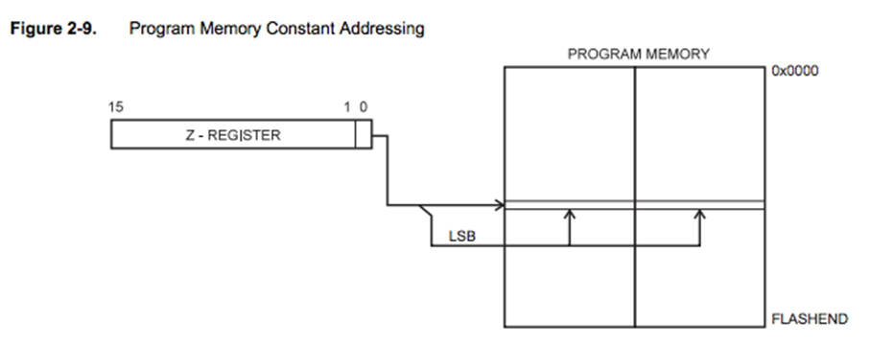

Memory manipulation: flash
lpm r16, Z ; r16 = *(r31:r30), but from flash
Note: code is separated from data

Slide 117
Bit manipulation instructions
sbr r16, 3 ; set bits 0 and 1 in r16
lsl r0 ; r0 << 2
lsr r1 ; r1 >> 2
rol r15 ; cyclic shift r16 bits to the left
ror r16 ; cyclic shift r16 bits to the right
cbr r18,1 ; clear bit 1 in r18
cbi $16, 1 ; PORTB[1] = 0

Slide 118

Ex 2.2: Blink! RE
cd /home/radare/workshop/ex2.2
avr-objcopy –I ihex –O binary blink.hex blink.bin
r2 –a avr blink.bin
Questions:
Identify main() function, define and rename it
Find the LED switching command
What type of delay is used and why accuracy of MCU frequency important?
Locate interrupt vector and init code, explain what happens inside init code

Slide 119
Reversing: function szignatures
Majority of firmware contains zero or little strings.
How to start?
Use function signatures.
However, in AVR world signatures may be to vary.
Be prepared to guess target compiler/library/RTOS and options… or bruteforce it.
In R2, signatures are called zignatures.

Slide 120
Working with zignatures

Slide 121
Embedded code priorities
Size
Speed
Hardware limits
Redundancy
…
…
…
…
Security

Slide 122
Fuzzing specifics
Fuzzing is a fuzzing. Everywhere.
But… we’re in embedded world
Sometimes you can detect crash through test/debug UART or pins
In most cases, you can detect crash only by noticing that device is no longer response
Moreover, watchdog timer can limit your detection capabilities by resetting the device
So how to detect crash?

Slide 123

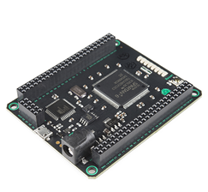
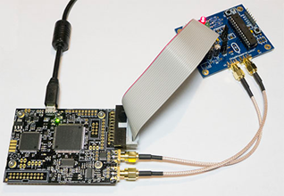
Fuzzing: ways to detect crash
JTAG debugger – break on RESET
External analysis of functionality – detect execution pauses
Detect bootloader/initialization code (e.g. for SRAM) behavior with logic analyzer and/or FPGA
Detect power consumption change with oscilloscope/DAQ

Slide 124

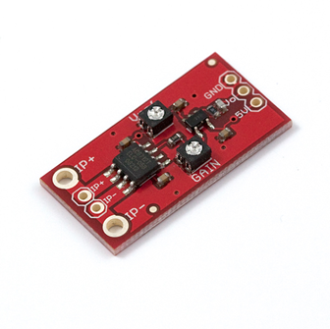
Sometimes Arduino is enough to detect
I²C and SPI init sequences could be captured by Arduino GPIOs
In case bootloader is slow and has ~1 second loading delay, this power consumption reduction could be reliably detected with cheap current sensor, e.g.:
+
SparkFun Low Current Sensor Breakout - ACS712
https://www.sparkfun.com/products/8883

Slide 125
Let’s proof it.

Slide 126
Part 3: Exploitation

Slide 127
Quick intro to ROP-chains
Return Oriented Programming
Series of function returns
We are searching for primitives (“gadgets”) ending with ‘ret’ that could be chained into a useful code sequence
SP is our new PC

Slide 128

Notice: Arduino
The next examples/exercises will be based upon Arduino ‘libc’ (in fact, Non-GNU AVR libc + Arduino wiring libs)
We’re using Arduino because it is sufficiently complex, full of gadgets and free (vs. IAR or CV which are also complex and full of gadgets)
Also, Arduino is fairly popular today due to enormous number of libraries and “quick start” (and quick bugs)

Slide 129
Ex 3.1 – 3.3
cd /home/radare/workshop/ex3.1
avarice --mkI --jtag /dev/ttyUSB0 -p -e --file build-crumbuino128/ex3.1.hex -d :4242
In the new terminal window:
avr-gdb
(gdb) target remote :4242

Slide 130
Ex 3.1_simulator-3.3
Simulator
cd /home/radare/workshop/ex3.1_simulator
simulavr -d atmega128 -f build-crumbuino128/ex3.1_simulator.elf -F 16000000 -x -,E1,9600 -y -,E0,9600
For debugging:
simulavr -d atmega128 -f build-crumbuino128/ex3.1_simulator.elf -F 16000000 -x -,E1,9600 -y -,E0,9600 –g
avr-gdb
(gdb) target remote :1212

Slide 131
Example 3.1 Abusing functionality: ret to function

Slide 132
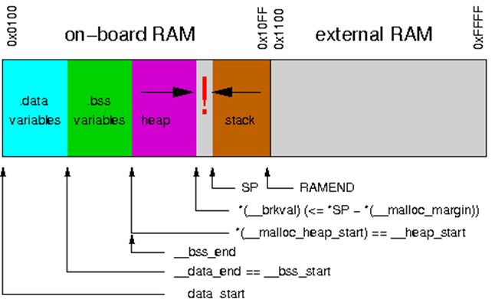
Internal-SRAM only memory map
Overflowing the heap => Rewriting the stack!
http://www.atmel.com/webdoc/AVRLibcReferenceManual/malloc_1malloc_intro.html

Slide 133
How to connect data(string/binary) to code?
Standard model: with .data variables
Determine data offset in flash
Find init code/firmware prologue where .data is copied to SRAM
Using debugging or own brain calculate offset of data in SRAM
Search code for this address
Economy model: direct read with lpm/elpm
Determine data offset in flash
Search code with *lpm addressing to this offset

Slide 134
ABI, Types and frame layouts (GCC)
Types: standard (short == int == 2, long == 4, except for double (4))
Int could be 8bit if -mint8 option is enforced
Call-used: R18–R27, R30, R31
Call-saved: R2–R17, R28, R29
R29:R28 used as frame pointer
Frame layout after function prologue:
incoming arguments
return address
saved registers
stack slots, Y+1 points at the bottom

Slide 135
Calling convention: arguments
An argument is passed either completely in registers or completely in memory
To find the register where a function argument is passed, initialize the register number R_{n} with R26 and follow the procedure:
If the argument size is an odd number of bytes, round up the size to the next even number.
Subtract the rounded number from the register number R_{n}.
If the new R_{n} is at least R18 and the size of the object is non-zero, then the low-byte of the argument is passed in R_{n}. Other bytes will be passed in R_{n+1}, R_{n+2}, etc.
If the new register number R_{n} is smaller than R18 or the size of the argument is zero, the argument will be passed in memory.
If the current argument is passed in memory, stop the procedure: All subsequent arguments will also be passed in memory.
If there are arguments left, goto 1. and proceed with the next argument.
Varagrs are passed on the stack

Slide 136
Calling conventions: returns
Return values of size 1 byte up to 8 bytes (including) will be returned in registers
For example, an 8-bit value is returned in R24 and an 32-bit value is returned R22...R25
Return values whose size is outside that range will be returned in memory

Slide 137
Example
For
int func (char a, long b);
a will be passed in R24
b will be passed in R20, R21, R22 and R23 with the LSB in R20 and the MSB in R23
The result is returned in R24 (LSB) and R25 (MSB)

Slide 138
Example 3.2 Abusing functionality: simple ROP

Slide 139
ROP gadget sources
User functions
“Standard” or RTOS functions
Data segment ☺
Bootloader section
More code => more gadgets

Slide 140
ROP chain size
It is MCU
SRAM is small
SRAM is divided between register file, heap and stack
Stack size is small
We are limited in chain size
Obviously, you will be constrained to 20-40 bytes (~15-30 gadgets)
However it all depends on compiler and memory model
http://www.atmel.com/webdoc/AVRLibcReferenceManual/malloc_1malloc_tunables.html

Slide 141
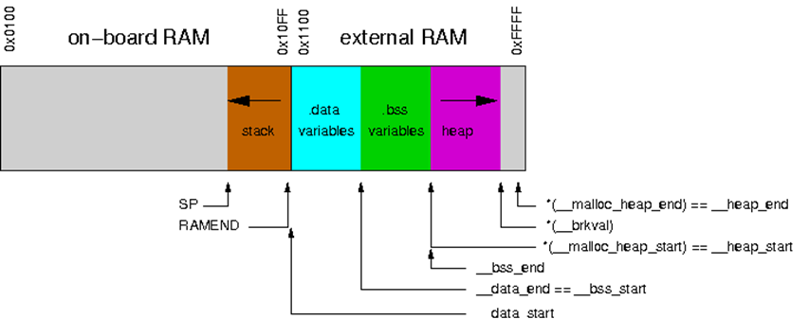
Memory maps – external SRAM/separated stack

Slide 142
Memory maps – external SRAM/mixed stack

Slide 143
Detecting “standard” functions
In AVR world there are a lot of different compilers, libraries and even RToSes
Thus, “standard” function could vary
More bad news: memory model and optimization options can change function
The best approach is to try to detect functions like malloc/str(n)cpy and then find the exact compiler/options that generates this code
After that, use function signatures to restore the rest of the code
In Radare2, you could use zignatures or Yara

Slide 144
Example 3.3 More complex ROP

Slide 145
Exercise 3.1 ret 2 function Build exploit that starts with ABC but calls switchgreen() function

Slide 146
Exercise 3.3 Print something else 3.3.1 Build exploit that prints “a few seconds…” 3.3.2 (homework) Build exploit that prints “blink a few seconds…”

Slide 147
It is possible to construct ROP with a debugger… …But if you don’t have one, how could you determine the overflow point?
Reverse firmware and use an external analysis to find function that overflows
Bruteforce it!

Slide 148
Arduino blink (ROP without debugger)
Connect Arduino board using MicroUSB cable
cd /home/radare/workshop/ex_arduino make upload (click reset on arduino just before it)
Run cutecom and connect to /dev/ttyACM0 using speed 9600

Slide 149
Arduino blink (ROP without debugger) Modify ROP chain to generate another blinking pattern

Slide 150
Part 4: Post-exploitation && Tricks

Slide 151
What do we want? (again)
Evade watchdog
Work with persistent memory (EEPROM and Flash)
Stay persistent in device
Control device over long time

Slide 152
Evade the watchdog
In most cases, there three ways:
Find a ROP with WDR and periodically jump on it
Find watchdog disabling code and try to jump on it
Construct watchdog disabling code using watchdog enabling code
Set r18 to 0 and JMP here

Slide 153

Fun and scary things to do with memory…
Read/write EEPROM (and extract cryptographic keys)
Read parts of flash (e.g., read locked bootloader section)
Could be more useful than it seems
Staying persistent (writing flash)

Slide 154
Reading EEPROM/Flash
In most cases it is easy to find gadget(s) that reads byte from EEPROM or flash and stores it somewhere
We could send this byte back over UART or any external channel gadgets
Not always possible, but there are good chances

Slide 155
Writing flash
Writing flash is locked during normal program execution
However, if you use “jump-to-bootloader” trick, you could write flash from bootloader sections
To do this, you need bootloader which has enough gadgets
Modern bootloaders are large and you may be lucky quite often (e.g. Arduino bootloader)
Remember to disable interrupts before jumping to bootloader

Slide 156
“Infinite-ROP” trick*
Set array to some “upper” stack address (A1) and N to some value (128/256/etc) and JMP to read(..)
Output ROP-chain from UART to A1.
Set SPH/SPL to A1 (gadgets could be got from init code)
JMP to RET.
???
Profit!
Don’t forget to include 1 and 3-4 gadgets in the ROP-chain that you are sending by UART.
*Possible on firmwares with read(array, N) from UART functions and complex init code

Slide 157
Mitigations

Slide 158
Mitigations (software)
Safe coding/Don’t trust external data (read 24 deadly sins of computer security)
Reduce code size (less code -> less ROP gadgets)
Use rjmp/jmp instead of call/ret (but it won’t save you from ret2 function)
Use “inconvenient” memory models with small stack
Use stack canaries in your RTOS
Limit external libraries
Use watchdogs
Periodically check stack limits (to avoid stack expansion tricks)

Slide 159
Mitigations (hardware)
Disable JTAG/debuggers/etc, remove pins/wires of JTAG/ISP/UART
Write lock bits to 0/0
Use multilayered PCBs
Use external/hardware watchdogs
Use modern MCUs (more secure against various hardware attacks)
Use external safety controls/processors
And last, but not least:
Beware of Dmitry Nedospasov ;-)

Slide 160
Conclusions
RCE on embedded systems isn’t so hard as it seems.
Abuse of functionality is the main consequence of such attacks
However, more scary things like extracting cipherkeys or rewriting the flash are possible
When developing embedded system remember that security also should be part of the software DLC process

Slide 161
Books/links
Atmega128 disasm thread: http://www.avrfreaks.net/forum/disassembly-atmega128-bin-file
Exploiting buffer overflows on arduino: http://electronics.stackexchange.com/questions/78880/exploiting-stack-buffer-overflows-on-an-arduino
Code Injection Attacks on Harvard-Architecture Devices: http://arxiv.org/pdf/0901.3482.pdf
Buffer overflow attack on an Atmega2560: http://www.avrfreaks.net/forum/buffer-overflow-attack-atmega2560?page=all
Jump to bootloader: http://www.avrfreaks.net/forum/jump-bootloader-app-help-needed
AVR Libc reference manual: http://www.atmel.com/webdoc/AVRLibcReferenceManual/overview_1overview_avr-libc.html
AVR GCC calling conventions: https://gcc.gnu.org/wiki/avr-gcc
Travis Goodspeed, Nifty Tricks and Sage Advice for Shellcode on Embedded Systems: https://conference.hitb.org/hitbsecconf2013ams/materials/D1T1%20-%20Travis%20Goodspeed%20-%20Nifty%20Tricks%20and%20Sage%20Advice%20for%20Shellcode%20on%20Embedded%20Systems.pdf
Pandora’s Cash Box: The Ghost Under Your POS: https://recon.cx/2015/slides/recon2015-17-nitay-artenstein-shift-reduce-Pandora-s-Cash-Box-The-Ghost-Under-Your-POS.pdf

Slide 162
Radare2. Links
http://radare.org
https://github.com/pwntester/cheatsheets/blob/master/radare2.md
https://www.gitbook.com/book/radare/radare2book/details
https://github.com/radare/radare2ida
Notes:
http://www.radare.org/r/

Slide 163

@dark_k3y
@dukeBarman
http://radare.org/r/

